Slide 1
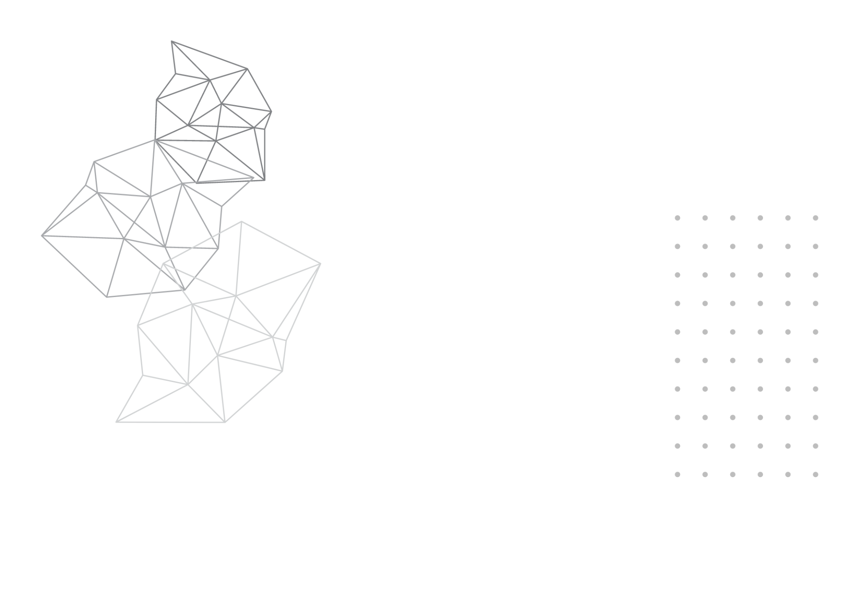

DeMedia
Decentralized Social Media Protocol
2023-234

Slide 2






DeMedia Team
Mr. Kavinga Abeywardena
Ms. Laneesha Ruggahakotuwa
Supervisor
Co-Supervisor
Perera B.S.S.
Bandara A.M.C.A.
Dhananjani G.G.S.
Abeykoon A.W.Y.I.K.
IT20254698
IT20159726
IT20137496
IT20157432

Slide 3




Introduction
What is a social media platform?
According to the Tufts University[1],
“Social media refers to the means of interactions among people in which they create, share, and/or exchange information and ideas in virtual communities and networks.”

Slide 4
Research Problem
Existing social media platforms do not allow users to govern the data they upload or share on their platforms. This has resulted in numerous disagreements among users, and major social media corporations use this user information to gain revenue while compromising the confidentiality of the user data to third parties.
The current social media platforms have given rise to a number of issues that prompt the need for a new approach to decentralized social media.

Slide 5
Research Problem Contd.
In particular, the following issues have come to the fore:
How to implement decentralized protocol to support social media platforms?
How to ensure transparency in the flow of application data?
How to grant users true control over their own data?
How to provide a centralized application like user experience on a decentralized application?

Slide 6
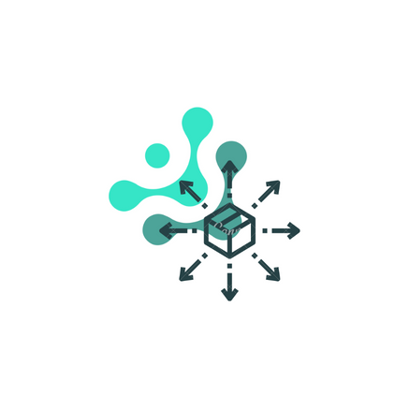


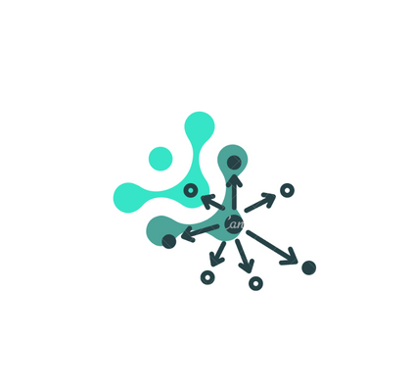
Solution
DeMedia - a protocol that facilitates the development of decentralized social media platforms.

Slide 7
Objectives
Implement a protocol that facilitates the development of decentralized social media platforms.
Implement a peer-to-peer
communication protocol
Implement user data
decentralization protocol
Implement a mechanism for
decentralized data integrity
Implement a mechanism for
decentralized
data caching

Slide 8
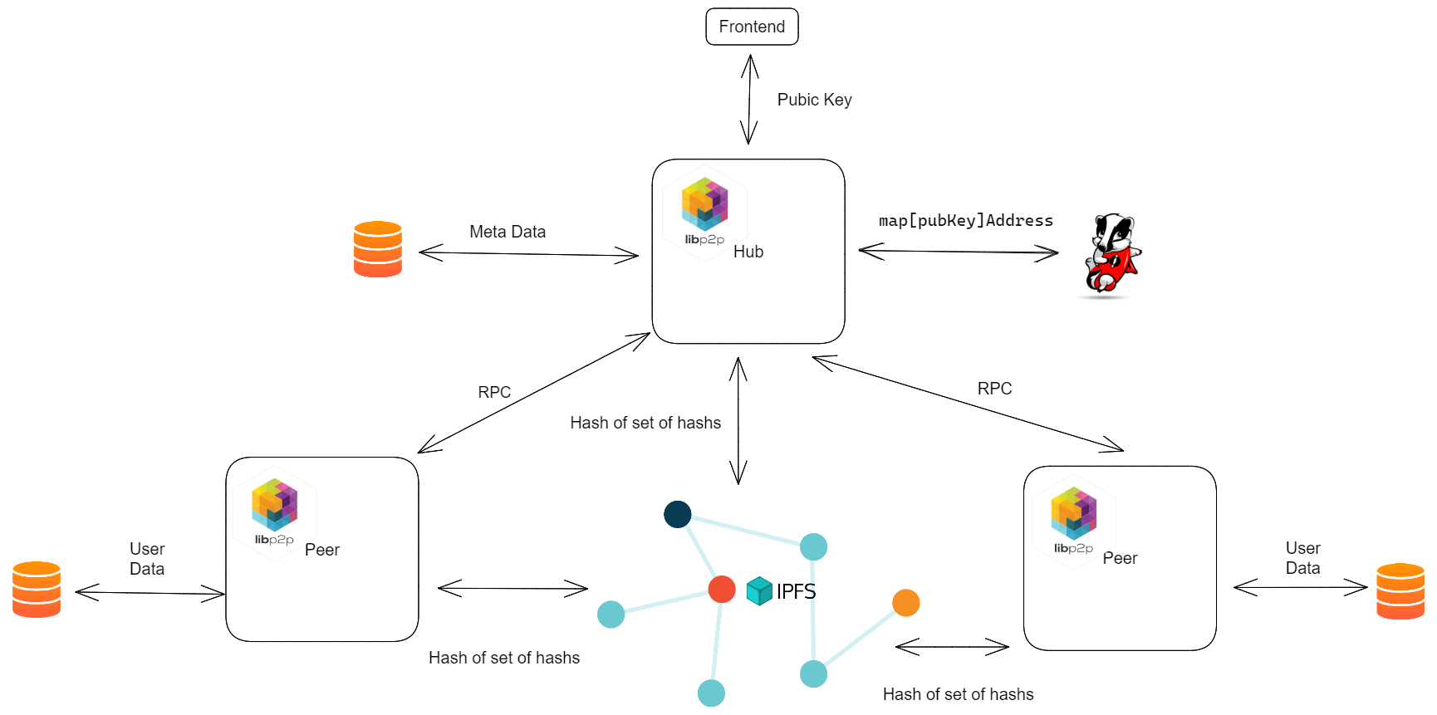
Overall System Architecture

Slide 9

System Integration
DeMedia protocol consist of the components mentioned in following sections and will integrate to one protocol.
A demo social media platform is developed to demonstrate the implemented protocol.

Slide 10
PERERA B.S.S | IT20254698 | IT
PEER TO PEER COMMUNICATION
IT20254698 | Perera B.S.S. | 2023 23-234

Slide 11





Introduction
Successful projects in past
Skype [1]
Gnutella [2]
Kazaa [2]
eMule [3]
Torrent [4]
IT20254698 | Perera B.S.S. | 2023 23-234

Slide 12
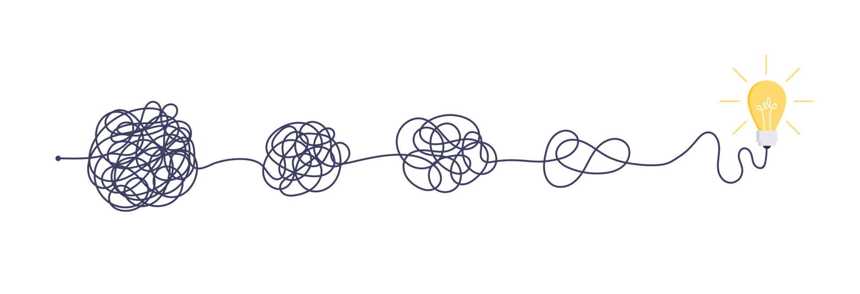
Research Problem
What is the best way to communicate in peer to peer network ?
How to scale peer to peer communication network ?
How to implement general purpose peer to peer protocol ?
IT20254698 | Perera B.S.S. | 2023 23-234

Slide 13

Sub Objectives
Design RPC style full duplex communication protocol
Use key-value store to keep track of peers
Utilizing third party storage providers for file sharing
Implement protocol with flexibility for any kind peer to peer communication
IT20254698 | Perera B.S.S. | 2023 23-234

Slide 14
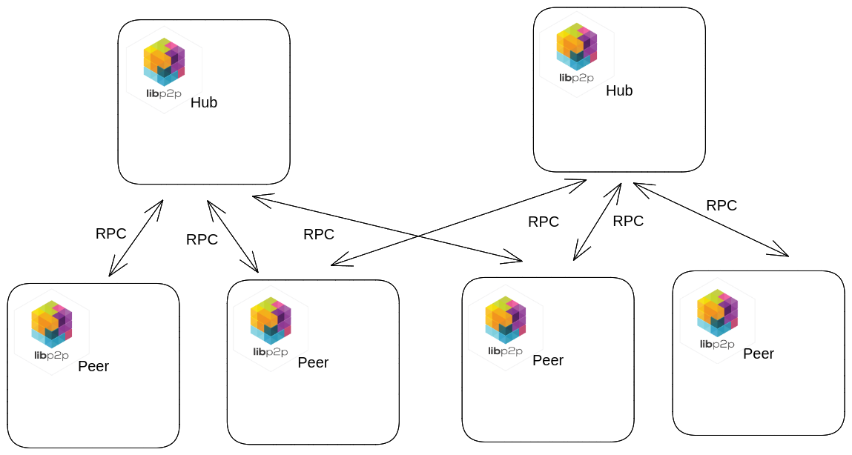
System Architecture
IT20254698 | Perera B.S.S. | 2023 23-234

Slide 15

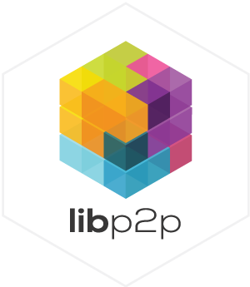

Technologies
IT20254698 | Perera B.S.S. | 2023 23-234

Slide 16
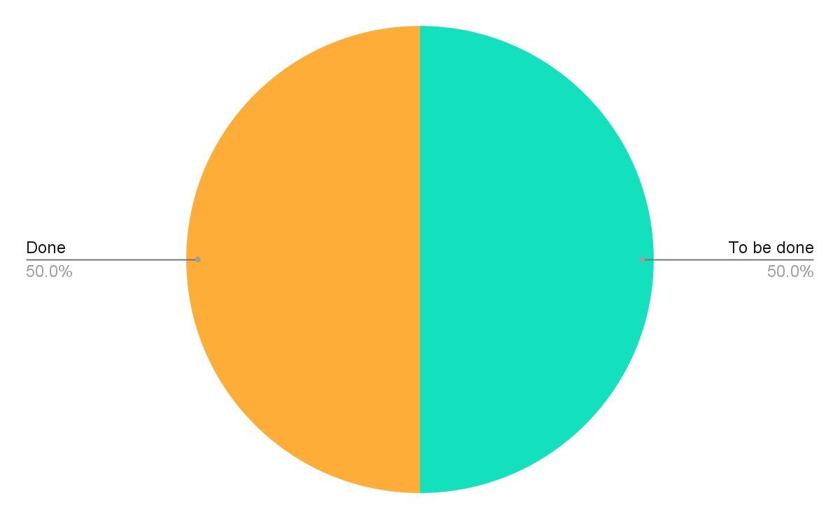
Progress of the Proposed Project
Establish connection between peers and hub
Implemented ping-pong scheme
Implemented DNS resolver
Implemented encryption layer
IT20254698 | Perera B.S.S. | 2023 23-234

Slide 17
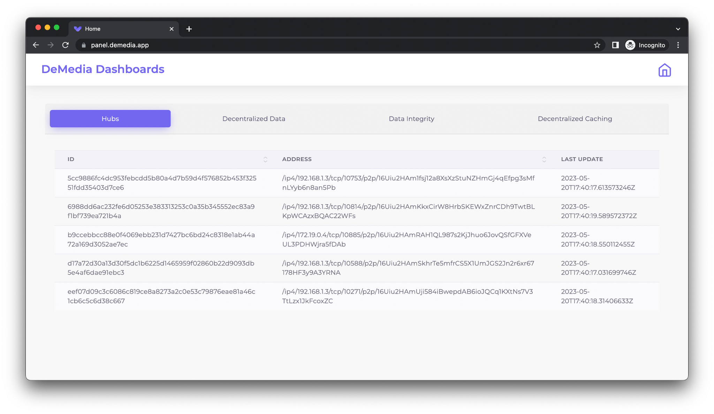
Progress of the Proposed Project Cont’d
IT20254698 | Perera B.S.S. | 2023 23-234

Slide 18
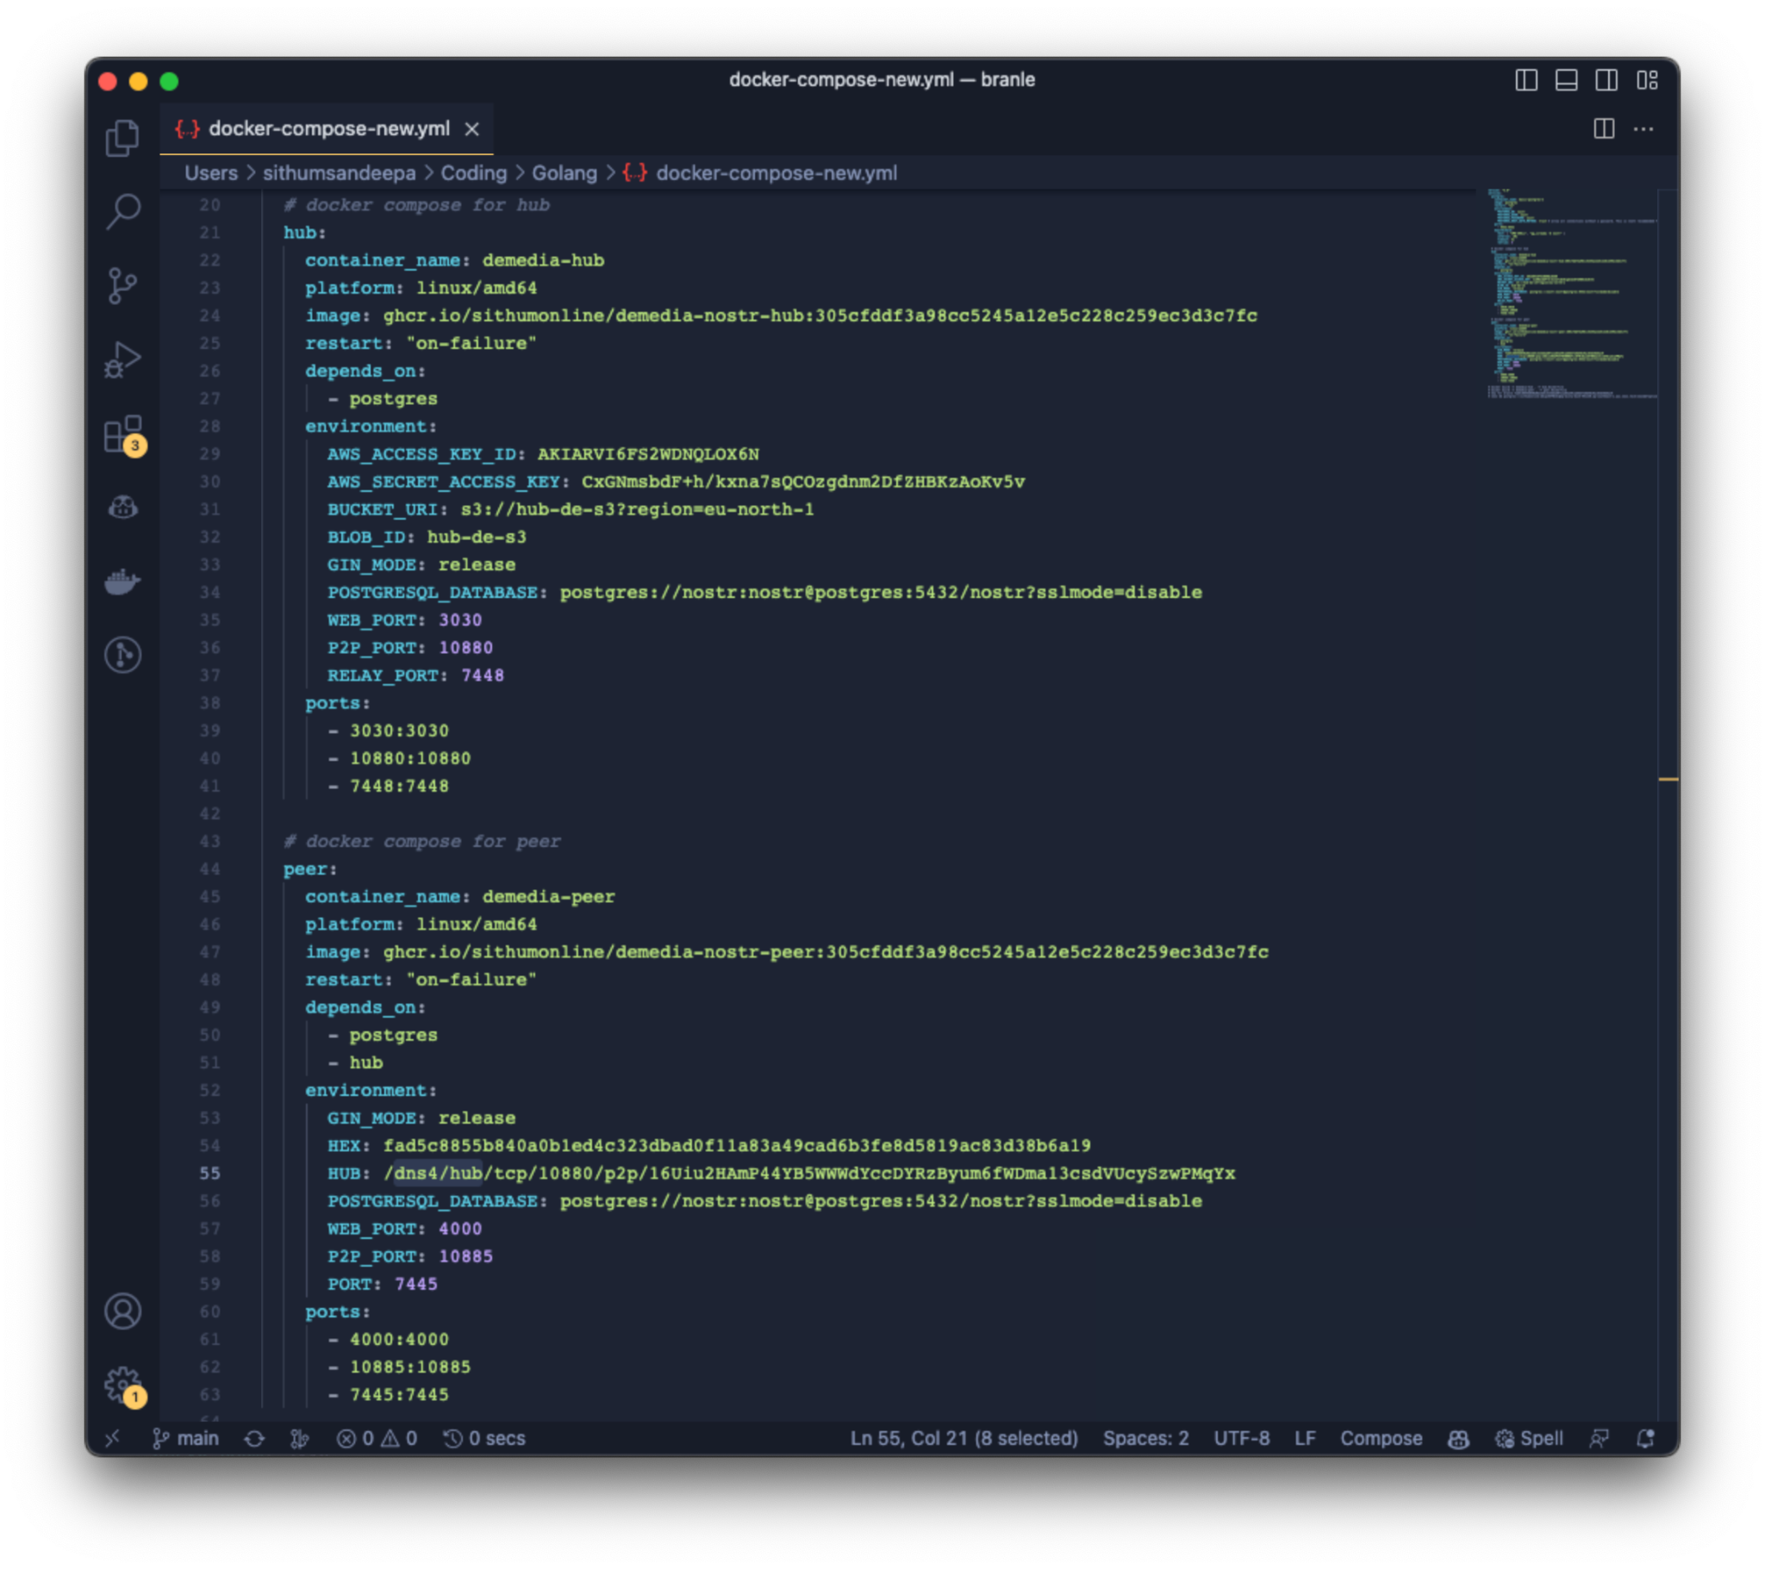
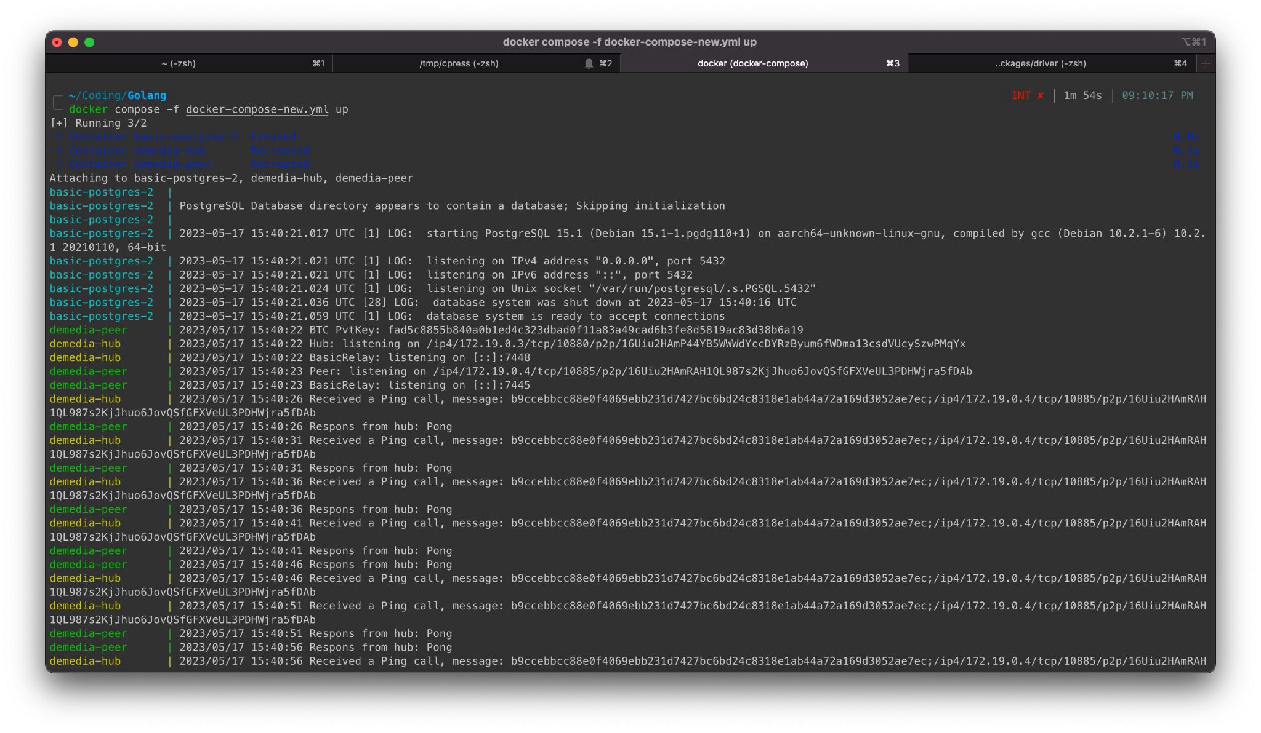
Progress of the Proposed Project Cont’d
IT20254698 | Perera B.S.S. | 2023 23-234

Slide 19

Future Implementation
Tracing and Observability
BadgerDB for keep map of connections
Proper logging
Unit and stress testing
IT20254698 | Perera B.S.S. | 2023 23-234

Slide 20
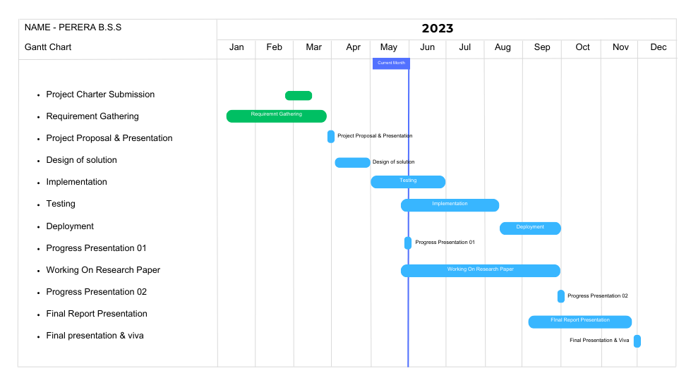
Completion Of The Project
IT20254698 | Perera B.S.S. | 2023 23-234

Slide 21
REFERENCES
[1] Y. A.-N. R. M. N. Mehdi Jahanirad*, "Security measures for VoIP application: A state of the art review" [Academic Journals, 2011].
[2] S. K. M. G. Leonidas Lymberopoulos, "Deliverable D.6.1: ARGUGRID Platform Design" [2007].
[3] D. B. Yoram Kulbak, "The eMule/eDonkey protocol," 2005 17 January. [Online]. Available: http://pages.di.unipi.it/ricci/e-mule-report.pdf. [Accessed: 24-Mar-2023].
[4] B. Cohen, 22 May 2003. [Online]. Available: https://stuker.com/wp-content/uploads/import/i-1fd3ae7c5502dfddfe8b2c7acdefaa5e-bittorrentecon.pdf.[Accessed: 24-Mar-2023].
IT20254698 | Perera B.S.S. | 2023 23-234

Slide 22
Bandara A.M.C.A. | IT20159726 | IT
USER DATA DECENTRALIZATION
PROTOCOL
IT20159726 | Bandara A.M.C.A. | 2023 23-234

Slide 23
Introduction
The primary goal is to grant complete data ownership control to the user.
Presently, numerous decentralized social media platforms exist in the market[1].
A significant proportion of these platforms are blockchain-based[2].
While many researches have been done on decentralizing social media[3],
Most of them are done using blockchain, which is not an optimal solution[4].
IT20159726 | Bandara A.M.C.A. | 2023 23-234

Slide 24
Research Problem
What measures can be taken to provide users with complete ownership of their data?
What potential solutions exist for overcoming the limitations of blockchain when using it to store large quantities of data?
What enhancements can be made to current decentralized social media networks?
IT20159726 | Bandara A.M.C.A. | 2023 23-234

Slide 25
Sub Objectives
Enable user to control user data
Utilizing user device to store user data
Improving limitations in current decentralized social media platforms
Making user data highly available
IT20159726 | Bandara A.M.C.A. | 2023 23-234

Slide 26
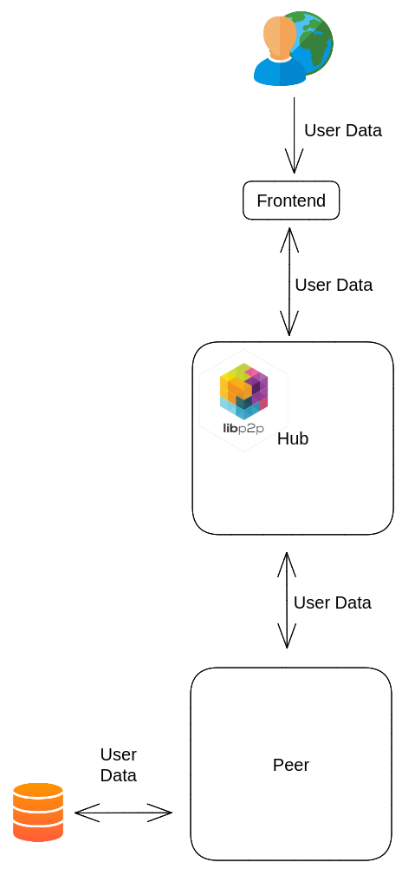
System Architecture
IT20159726 | Bandara A.M.C.A. | 2023 23-234

Slide 27

Technologies
IT20159726 | Bandara A.M.C.A. | 2023 23-234

Slide 28
Progress of the Proposed Project
Implemented the establishment of connection with hubs.
Implemented the content creation as a user.
Implemented the uploading of content to hubs.
Implemented the handling of locally stored data.
IT20159726 | Bandara A.M.C.A. | 2023 23-234

Slide 29
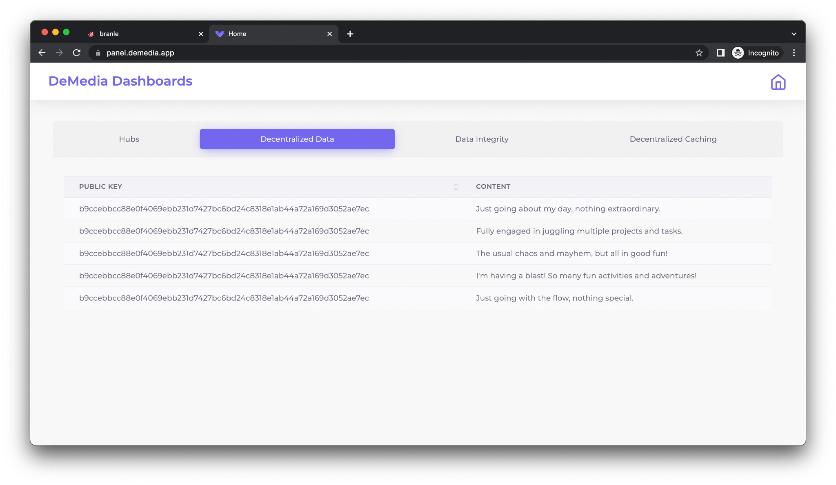
Progress of the Proposed Project Cont’d
IT20159726 | Bandara A.M.C.A. | 2023 23-234

Slide 30
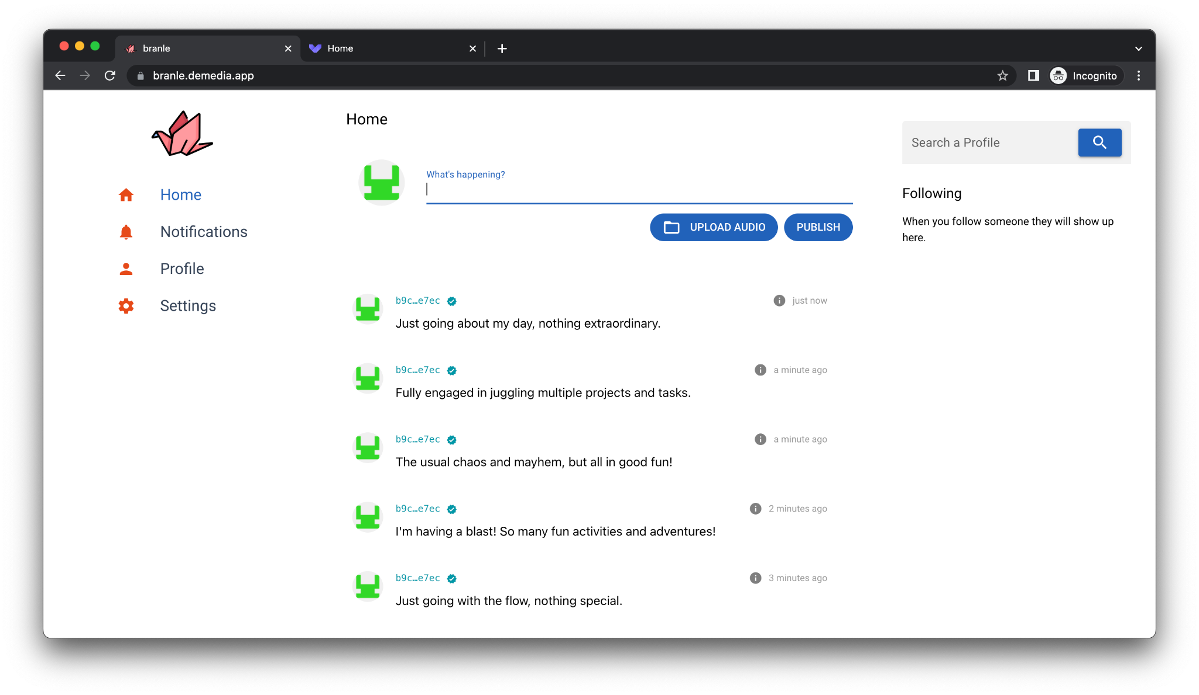
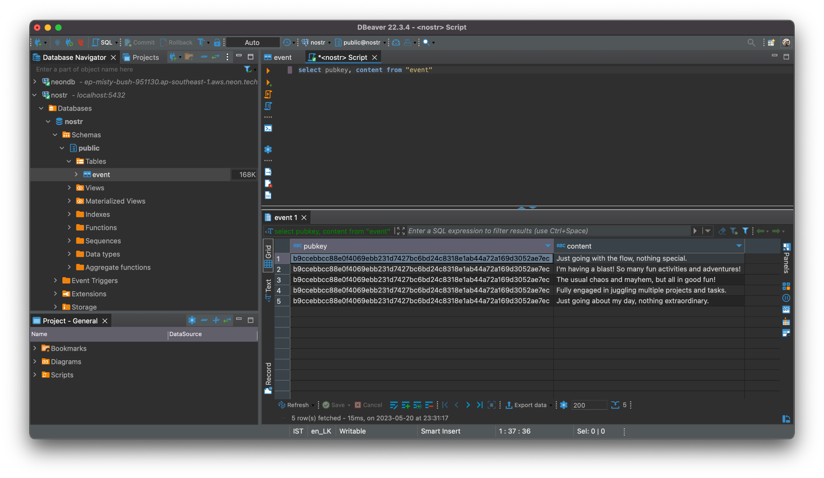
Progress of the Proposed Project Cont’d
IT20159726 | Bandara A.M.C.A. | 2023 23-234

Slide 31
Future Implementation
Integration of local storage with IPFS
Tracing and Observability
Data backup
Unit and load testing
IT20159726 | Bandara A.M.C.A. | 2023 23-234

Slide 32

Completion Of The Project
IT20159726 | Bandara A.M.C.A. | 2023 23-234

Slide 33
REFERENCES
[1]. C. Staff, “Blockchain social media and crypto social media,” Cryptopedia . [Online]. Available: https://www.gemini.com/cryptopedia/blockchain-social-media-decentralized-social-media#section-blockchain-and-social-media. [Accessed: 20-Mar-2023].
[2]. Sketchar, “What advantages does web 3.0 give to creators?,” Sketchar, 03-Mar-2023. [Online]. Available: https://blog.sketchar.io/what-advantages-does-web-3-0-give-to-creators/. [Accessed: 20-Mar-2023].
[3]. T. Cai, Z. Hong, S. Liu, W. Chen, Z. Zheng and Y. Yu, "SocialChain: Decoupling Social Data and Applications to Return Your Data Ownership," in IEEE Transactions on Services Computing, vol. 16, no. 1, pp. 600-614, 1 Jan.-Feb. 2023, doi: 10.1109/TSC.2021.3128959.
[4]. R. Nourmohammadi and K. Zhang, "An On-Chain Governance Model Based on Particle Swarm Optimization for Reducing Blockchain Forks," in IEEE Access, vol. 10, pp. 118965-118980, 2022, doi: 10.1109/ACCESS.2022.3221419.
[5]. “Decentralized social media,” Mastodon. [Online]. Available: https://joinmastodon.org/. [Accessed: 20-Mar-2023].
[6]. S. Freight, “The decentralized social blockchain,” DeSo. [Online]. Available: https://www.deso.com/. [Accessed: 20-Mar-2023].
IT20159726 | Bandara A.M.C.A. | 2023 23-234

Slide 34
Dhananjani G.G.S. | IT20137496 | IT
DECENTRALIZED DATA INTEGRITY
IT20137496 | Dhananjani G.G.S. | 2023 23-234

Slide 35
Introduction
Data integrity is a main aspect of any application. [1]
Currently, there are various mechanisms available to maintain the integrity of data in decentralised application.
In here, try to implement a proper data integrity mechanism on top of IPFS.
IT20137496 | Dhananjani G.G.S. | 2023 23-234

Slide 36

Research Problem
How to maintain integrity of user data which saved on user device?
What is the best mechanism for achieve user data integrity?
How to ensure user data integrity using IPFS network? [2]
IT20137496 | Dhananjani G.G.S. | 2023 23-234

Slide 37
Sub Objectives
Ensure consistency in preparation for hashing and signing
Ensures the data security distributed across multiple nodes
Verify the authenticity of the data
Ensure that the data has not been altered or tampered with during storage
IT20137496 | Dhananjani G.G.S. | 2023 23-234

Slide 38
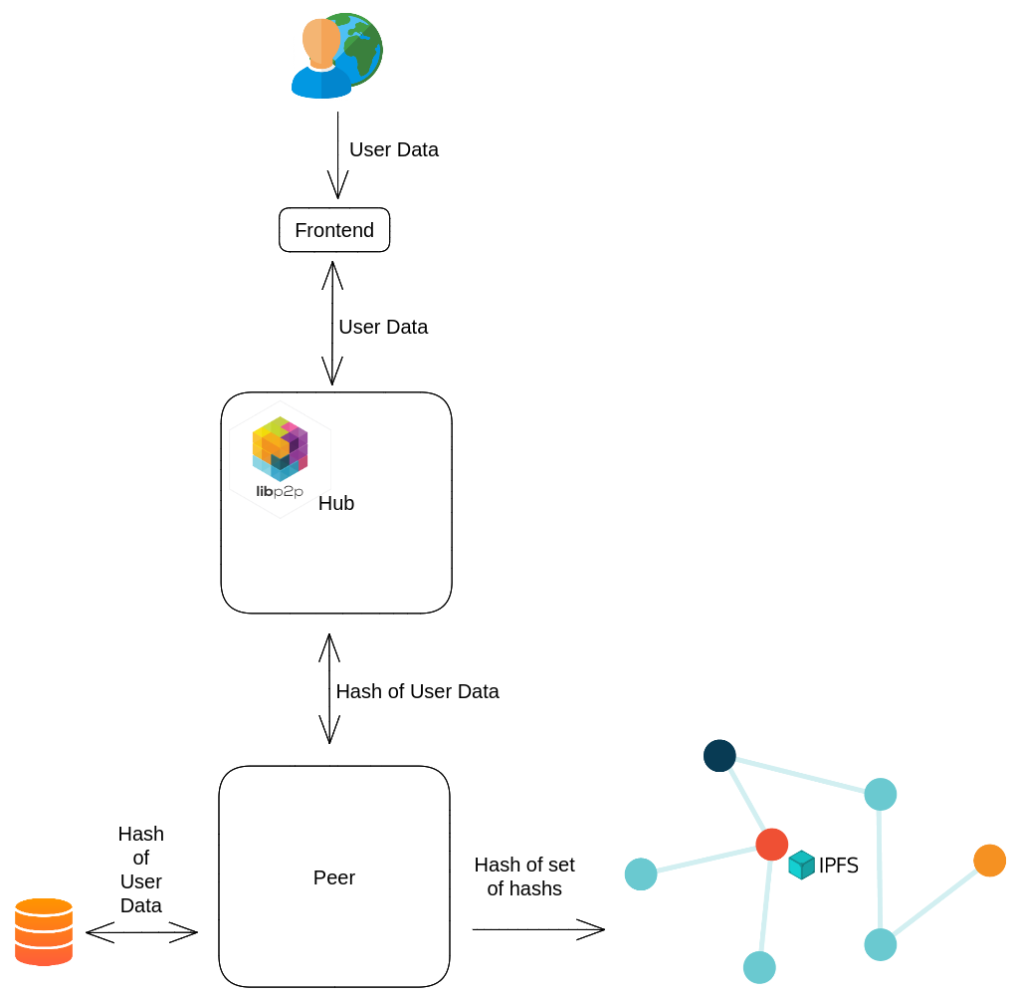
System Architecture
IT20137496 | Dhananjani G.G.S. | 2023 23-234

Slide 39

Technologies
IT20137496 | Dhananjani G.G.S. | 2023 23-234

Slide 40
Progress of the Proposed Project
Implemented hashing of data
Implemented hashing of multimedia
Implemented persist hashes on database
Implemented verified flag
IT20137496 | Dhananjani G.G.S. | 2023 23-234

Slide 41
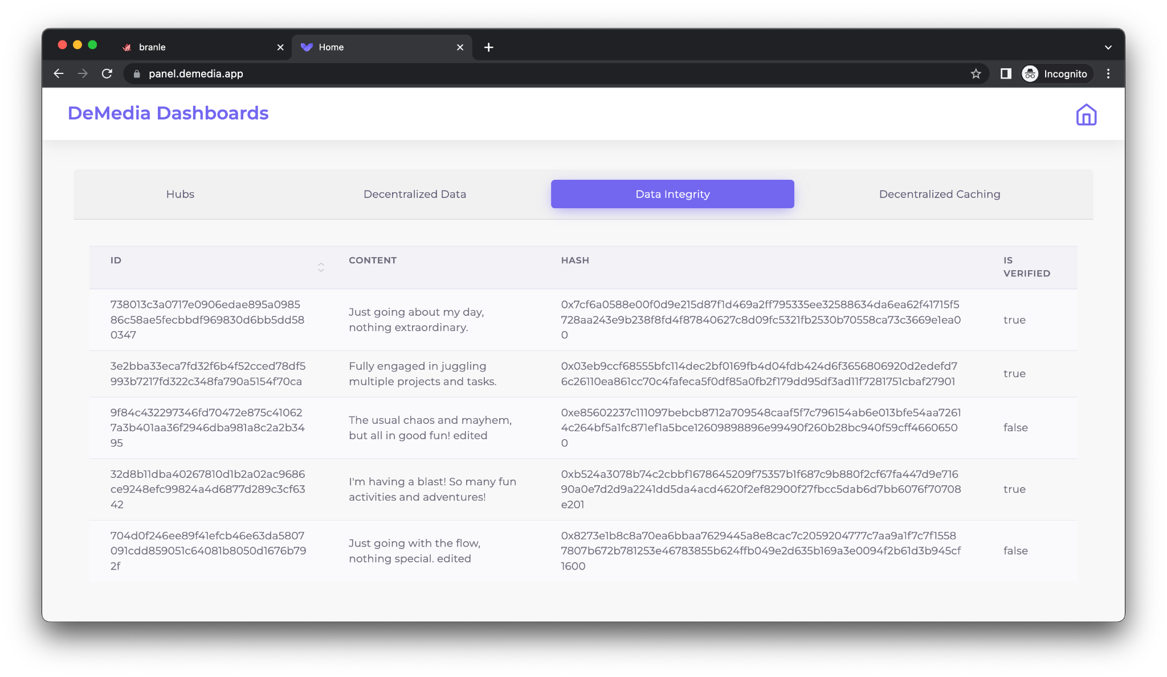
Progress of the Proposed Project Cont’d
IT20137496 | Dhananjani G.G.S. | 2023 23-234

Slide 42
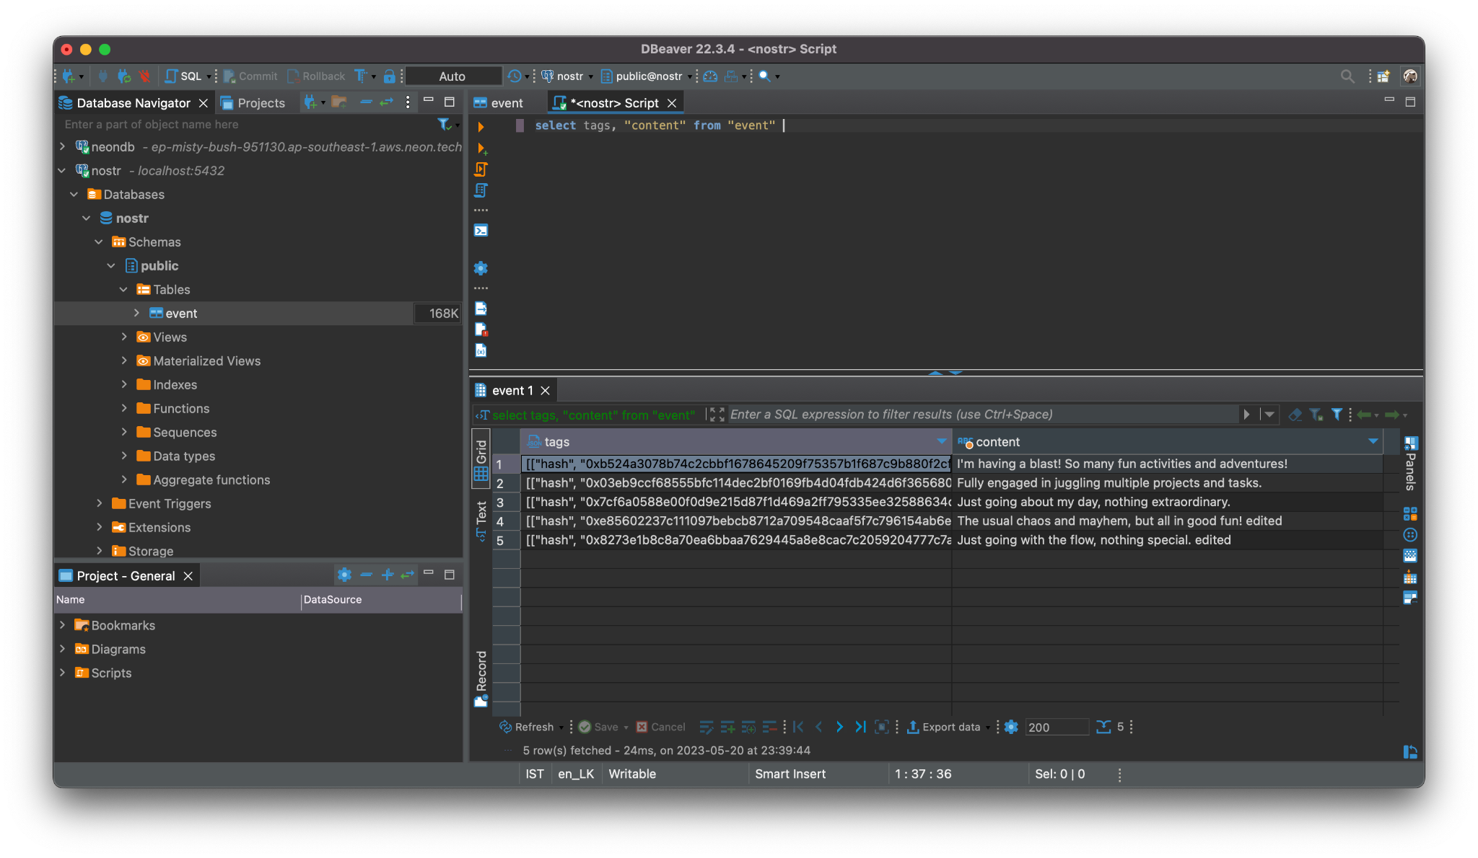

Progress of the Proposed Project Cont’d
IT20137496 | Dhananjani G.G.S. | 2023 23-234

Slide 43
Future Implementation
Publish master hash on IPFS
Filter unverified content
Allow purge unverified content
Unit testing
IT20137496 | Dhananjani G.G.S. | 2023 23-234

Slide 44

Completion Of The Project
IT20137496 | Dhananjani G.G.S. | 2023 23-234

Slide 45
REFERENCES
[1] Vishwanath G. Garagad, Nalini C. Iyer, Heera G. Wali, "Data Integrity: A security threat for Internet of Things and Cyber-Physical Systems", IEEE 2020.
[2] Kelsie Nabben ,"Decentralized Technology in Practice: Social and technical resilience in IPFS", IEEE, 2022.
[3] “Decentralized social media,” Mastodon. [Online]. Available: https://joinmastodon.org/. [Accessed: 20-Mar-2023].
[4] S. Freight, “The decentralized social blockchain,” DeSo. [Online]. Available: https://www.deso.com/. [Accessed: 20-Mar-2023].
[5] “What is the Mastodon social media platform?,” Internet Matters, 15-Mar-2023. [Online]. Available: https://www.internetmatters.org/hub/news-blogs/what-is-mastodon-social-media/. [Accessed: 20-Mar-2023].
[6] "IPFS Docs," [Online]. Available: https://docs.ipfs.tech/.
[7] Quanqing Xu, “Building an Ethereum and IPFS-Based Decentralized Social Network System”, IEEE, 2018.
[8] Ma Haifeng, Zhang Ji, "Block-chain based cloud storage integrity verifycation scheme for recoverable data", IEEE 2022.
[9] Biwen Chen, "A Blockchain-Based Searchable Public-Key Encryption With Forward and Backward Privacy for Cloud-Assisted Vehicular Social Networks", IEEE 2022.
[10] Subhashish Mazumdar, "From data integrity to inference integrity", IEEE 2017.
[11] Bogdan Tiganoaia, "The use of social platforms and personal data protection — An exploratory study" IEEE, 2017.
IT20137496 | Dhananjani G.G.S. | 2023 23-234

Slide 46
ABEYKOON A.W.Y.I.K. | IT20157432 | IT
DECENTRALIZED DATA CACHING
IT20157432 | Abeykoon A.W.Y.I.K. | 2023 23-234

Slide 47
Introduction
“Caching your way to a decentralized social media experience that's fast and efficient”[1]
Decentralized social media protocols that preserve data caching are essential for improving network performance, reducing traffic, and improving scalability, dependability, and cost effectiveness. They also increase storage optimization and reduce the cost of network operations. [2]
Ex :Diaspora, Scuttlebutt, Peepath, Steemit, Minds, Akasha
There are many kind of decentralized storage networks [3]
Ex : Storj, Filecon, Arware , BitTorrent, IPFs (InterPlanetary File System)
IT20157432 | Abeykoon A.W.Y.I.K. | 2023 23-234

Slide 48

Research Problem
What is the most effective caching strategy for issues of caching mechanism?
What we can do for minimize resource usage?
Why we use IPFS to implement the caching mechanism?
IT20157432 | Abeykoon A.W.Y.I.K. | 2023 23-234

Slide 49
Sub Objectives
Integrating the caching mechanism with the IPFS
Reduce resource consumption in data storage
Improve Scalability, Efficiency, and Flexibility, Lower transaction fees
To evaluate the ease of integration and development efficiency
IT20157432 | Abeykoon A.W.Y.I.K. | 2023 23-234

Slide 50
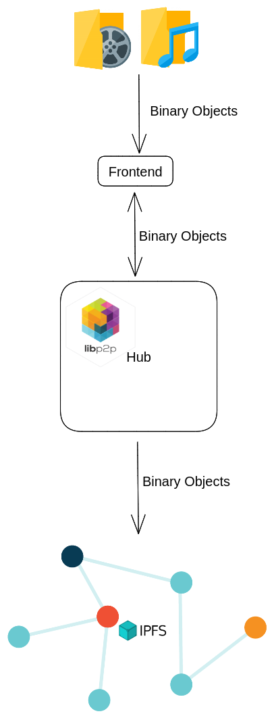
System Architecture
IT20157432 | Abeykoon A.W.Y.I.K. | 2023 23-234

Slide 51
Technologies
IT20157432 | Abeykoon A.W.Y.I.K. | 2023 23-234

Slide 52
Progress of the Proposed Project
Upload binary objects to cloud storage
Retrieve binary objects from cloud storage
Hash metadata of binary objects
Keep map of binary objects content and users
IT20157432 | Abeykoon A.W.Y.I.K. | 2023 23-234

Slide 53
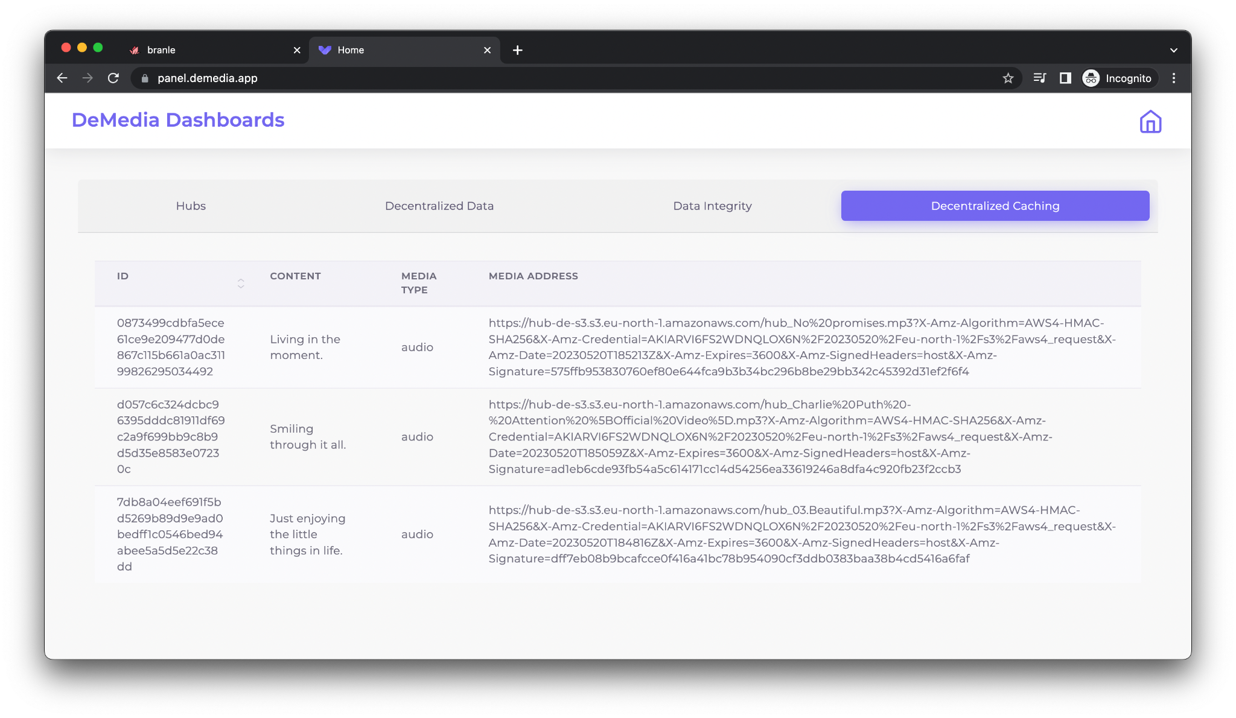
Progress of the Proposed Project Cont’d
IT20157432 | Abeykoon A.W.Y.I.K. | 2023 23-234

Slide 54
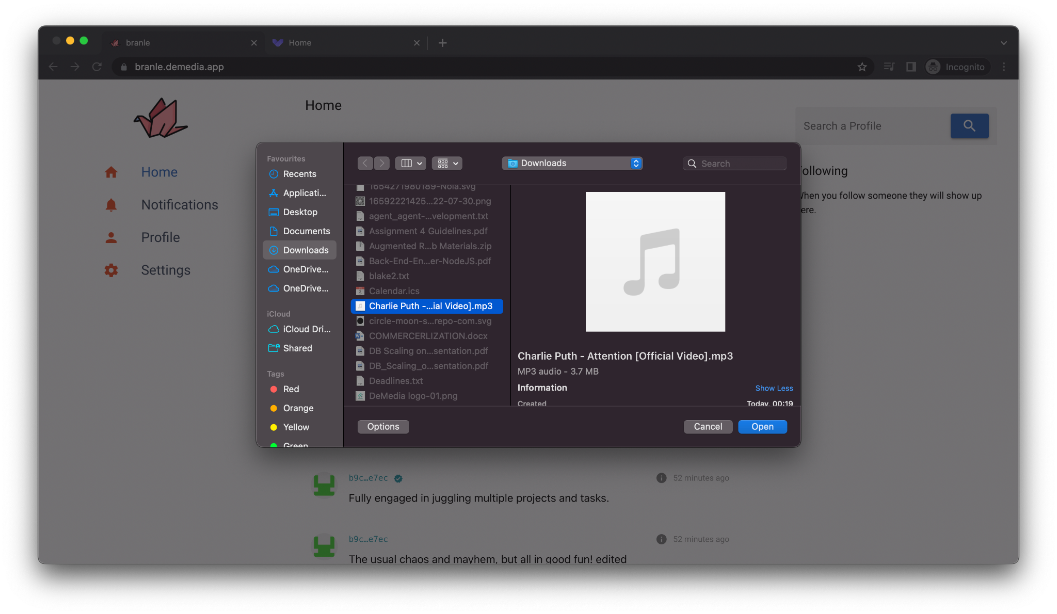
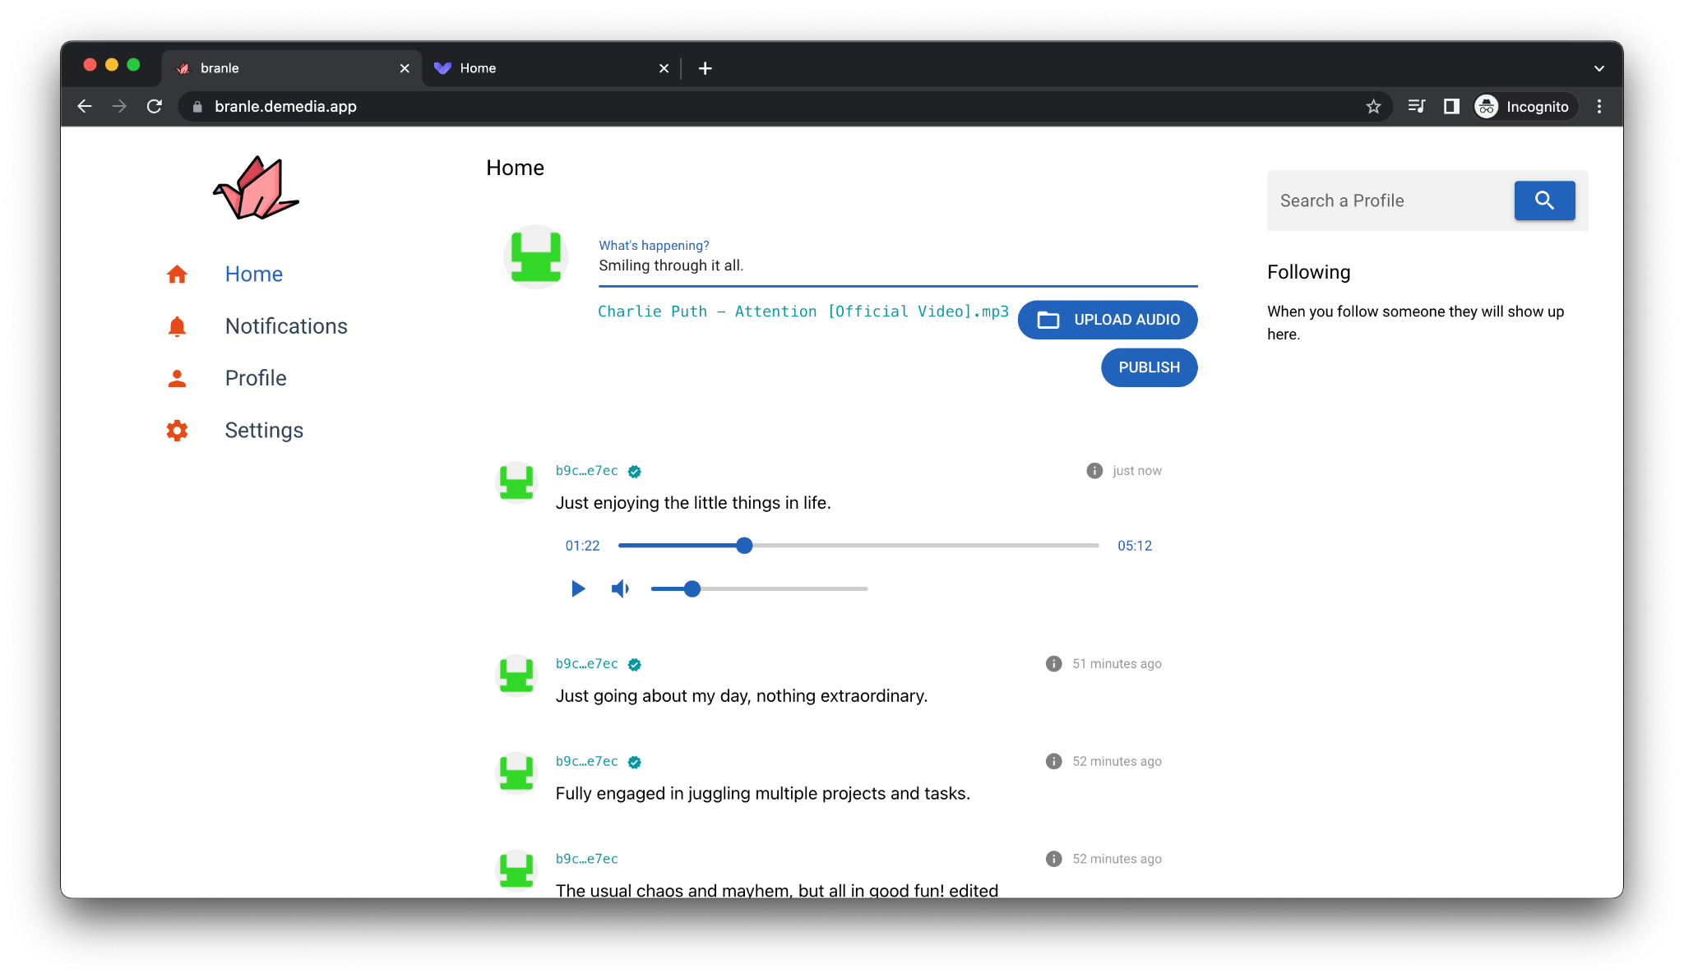
Progress of the Proposed Project Cont’d
IT20157432 | Abeykoon A.W.Y.I.K. | 2023 23-234

Slide 55
Future Implementation
Utilize IPFS for cloud storage
Verify binary objects content
Allow to Purge binary objects
Load and unit testing
IT20157432 | Abeykoon A.W.Y.I.K. | 2023 23-234

Slide 56

Completion Of The Project
IT20157432 | Abeykoon A.W.Y.I.K. | 2023 23-234

Slide 57
REFERENCES
[1] R. Schollmeier, "A definition of peer-to-peer networking for the classification of peer-to-peer architectures and applications," IEEE, 2001.
[2] F. A. Alabdulwahhab, "Web 3.0: The Decentralized Web Blockchain networks and Protocol Innovation," IEEE, 2019.
[4] B. Zhang and H. Wu, "A new distributed caching replacement strategy," IEEE, 2011.
[5] B. P. Robert Sheldon, "7 decentralized data storage networks compared," TechTarget, 05 June 2022. [Online]. Available: https://www.techtarget.com/searchstorage/tip/Comparing-4-decentralized-data-storage-offerings.
[6] F. T. Erik Daniel, "IPFS and Friends: A Qualitative Comparison of Next Generation Peer-to-Peer Data Networks," IEEE, 2022.
[7] M. K. G. Newton Masinde, "Caching Structures for Distributed Data Management in P2P-based Social Networks," IEEE, Montreal, QC, Canada, 2020.
[8] D. J. Tharuka Sarathchandra, "A decentralized social network architecture," IEEE, 2021.
[9] M. P. B. N. S. M. a. L. I. L. Han, "SocialCDN: Caching techniques for distributed social networks," IEEE 12th International Conference, Tarragona, Spain, 2012.
[10] N. K. M. a. G. K. Masinde, "Caching structures for distributed data management in P2P-based social networks," IEEE, Montreal, QC, Canada, 2020.
[11] "IPFS Docs," [Online]. Available: https://docs.ipfs.tech/.
IT20157432 | Abeykoon A.W.Y.I.K. | 2023 23-234

Slide 58
Commercialization Plan
DeMedia is slated to function as an open source protocol, facilitating the creation of decentralized social media platforms that are self-hosted.
DeMedia will provide
A base model which can be utilized for free of charge.
Additionally 2 paid models will also available:
A membership model based on subscription, which can be governed by the host
An advertising-based revenue model that can also be governed by the host

Slide 59

Q & A

Slide 60
Thank You!
2023 23-234

Slide 61
Demo
2023 23-234

